Slide 3
Elastic search is a distributed open source analytics and text search engine platform. It's often used for enabling search option for your application.It’s JSON based database(No SQL). It’s built on Apache Lucene.
For example you have a blog for which you want users to be able to search. That could be a blog posts ,categories, products etc..We can also sort them by popularity , rating , cost etc.
Elastic search can be used as an analytics platform. Most used case of the elastic search is Application performance management by the use of analytics of elastic search.

Slide 4
Data is stored as documents(like rows in SQL).Document’s data is separated into fields(like Columns in SQL).
Example Document:
{
First name: "Peter” Field values
Last Name: "Johnson”
Includes: “ Logstash ”, ” Kibana ” ,” Elastic stack”
}
An index is a collection of documents that have similar characteristics.

Slide 5
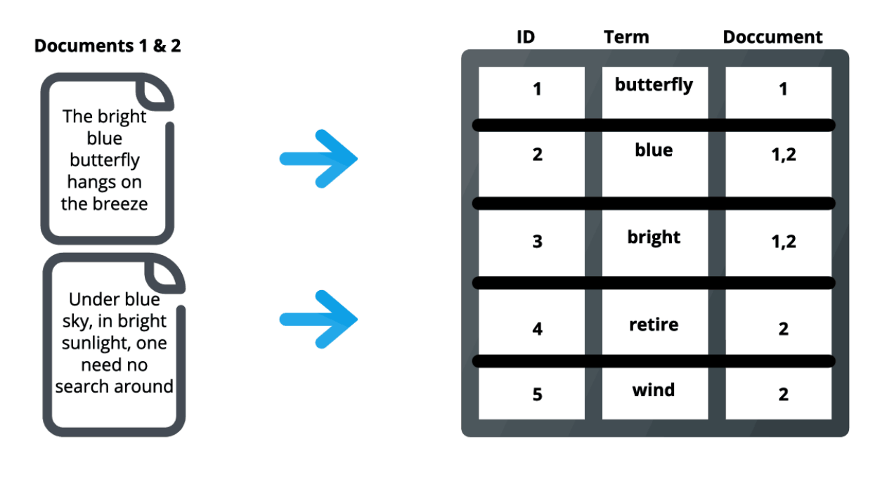
Inverted index
An index in Elasticsearch is actually what’s called an inverted index.(words to documents)
It is a data structure that stores a mapping from content, such as words or numbers, to its locations in a document or a set of documents
. An inverted index doesn’t store strings directly and instead splits each document up to individual search terms (i.e. each word) then maps each search term to the documents those search terms occur within.
For example, in the image below, the term “best” occurs in document 2, so it is mapped to that document. This serves as a quick look-up of where to find search terms in a given document. By using distributed inverted indices, Elasticsearch quickly finds the best matches for full-text searches from even very large data sets.

Slide 6
Advantages of elastic search
Fast time-to-value
Elasticsearch offers simple REST-based APIs, a simple HTTP interface, and uses schema-free JSON documents, making it easy to get started and quickly build applications for various use cases.
High performance
The distributed nature of Elasticsearch enables it to process large volumes of data in parallel, quickly finding the best matches for your queries.
Complimentary tooling and plugins
Elasticsearch comes integrated with Kibana, a popular visualization and reporting tool. It also offers integration with Beats and Logstash, helping you easily transform source data and load it into your Elasticsearch cluster. You can also use various open-source Elasticsearch plugins such as language analyzers and suggesters to add rich functionality to your applications.
Near real-time operations
Elasticsearch operations such as reading or writing data usually take less than a second to complete. This lets you use Elasticsearch for near real-time use cases such as application monitoring and anomaly detection.
Easy application development
Elasticsearch provides support for various languages including Java, Python, PHP, JavaScript, Node.js, Ruby, and many more.

Slide 7
ELK Stack components
Kibana: Web based UI. Like dashboard for CPU ,memory usage.widgets, visualizations and analytics platform.
LogStash: Open source server side processing pipeline.There are 3 stages
of this pipeline input ,filter, output. Each is done by a different plugin

Slide 8
Logstash pipeline
input {
file {
path => "/path/to/apache_access.log“
}
}
filter {
if [request] in ["/robots.txt", "/favicon.ico"]
drop { }
}
}
output {
file {
path => "%{type} %{+yyyy_MM_dd}.log“
}
}

Slide 9
The speed and scalability of Elasticsearch and its ability to index many types of content mean that it can be used for a number of use cases:
Application search
Website search
Enterprise search
Logging and log analytics
Infrastructure metrics and container monitoring
Application performance monitoring
Geospatial data analysis and visualization
Security analytics
Business analytics

Slide 10
Backend Components
Cluster
An Elasticsearch cluster is a group of one or more node instances that are connected together. The power of an Elasticsearch cluster lies in the distribution of tasks, searching, and indexing, across all the nodes in the cluster.
Node
A node is a single server that is a part of a cluster. A node stores data and participates in the cluster’s indexing and search capabilities. An Elasticsearch node can be configured in different ways: Master Node — Controls the Elasticsearch cluster and is responsible for all cluster-wide operations like creating/deleting an index and adding/removing nodes. Data Node — Stores data and executes data-related operations such as search and aggregation. Client Node — Forwards cluster requests to the master node and data-related requests to data nodes.
Shards
Elasticsearch provides the ability to subdivide the index into multiple pieces called shards. Each shard is in itself a fully-functional and independent “index” that can be hosted on any node within a cluster. By distributing the documents in an index across multiple shards, and distributing those shards across multiple nodes, Elasticsearch can ensure redundancy, which both protects against hardware failures and increases query capacity as nodes are added to a cluster.
Replicas
Elasticsearch allows you to make one or more copies of your index’s shards which are called “replica shards” or just “replicas”. Basically, a replica shard is a copy of a primary shard. Each document in an index belongs to one primary shard. Replicas provide redundant copies of your data to protect against hardware failure and increase capacity to serve read requests like searching or retrieving a document.

